Slide 2

The problem
Utilizing ti opt3020 for locating obstacles and abyss locations in single frames:
Main difficulties:
Naive lens calibration function -> objects are not placed properly
Black objects return noisy phase ( depth ) data
Low resolution 80 x 60
Phase data sensitive to external illumination such as sunlight
Phase data sensitive to reflective objects
Single frame approach was chosen to decouple the problem from localization

Slide 3
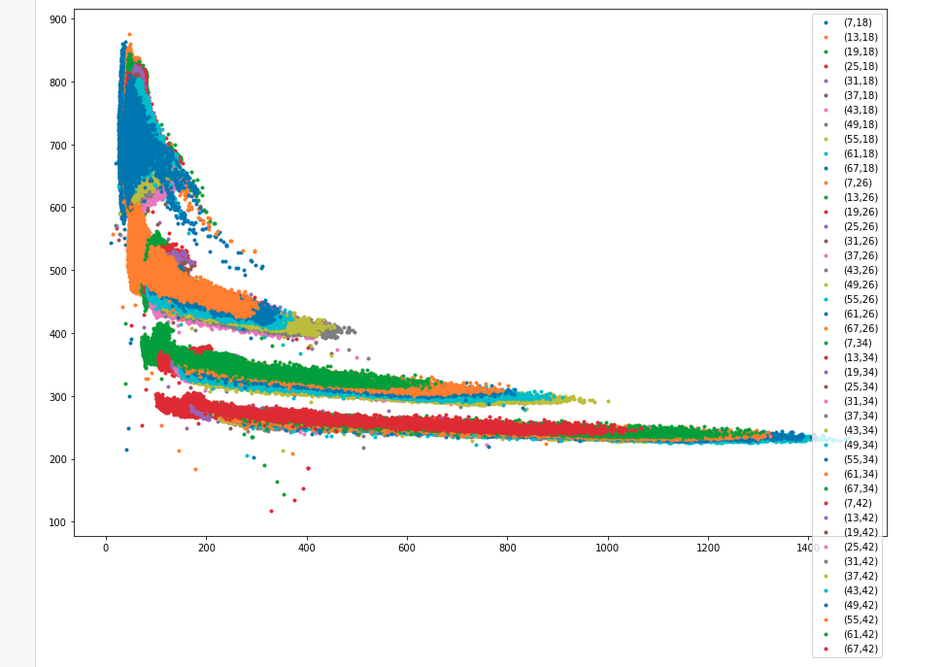

Raw data experiments - black objects problem explained
Intensity vs error graph
+- ~0.15m error at intensity values under 120
Ground truth values are set as depth at the 9 precentile of intensity
0.3 m
Depth
Intensity

Slide 4
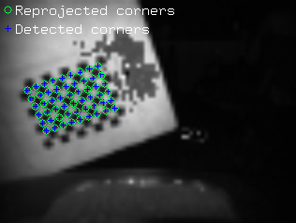
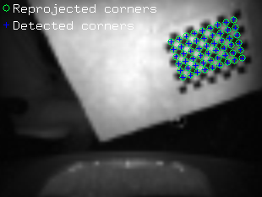
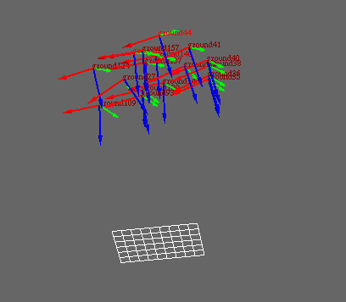
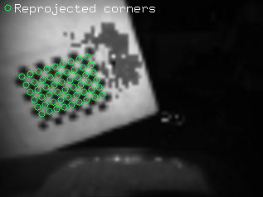
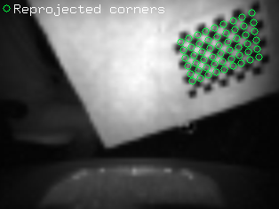
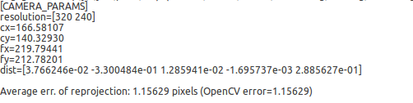
Calibration process

Slide 5

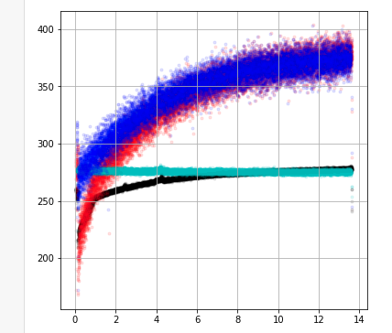
Warmup bias and self phase process
Template matching for a small patch, calculate average depth to the patch
Self phase is also a measure of the warmup time
Self phase / warmup correction is currently not used on master , but the infrastructure exists:
High intensity pixel warmup graph
High intensity pixel warmup graph after fix
Low intensity pixel warmup graph
Low intensity pixel warmup graph after fix
Phase [~mm]
Time [m]

Slide 6
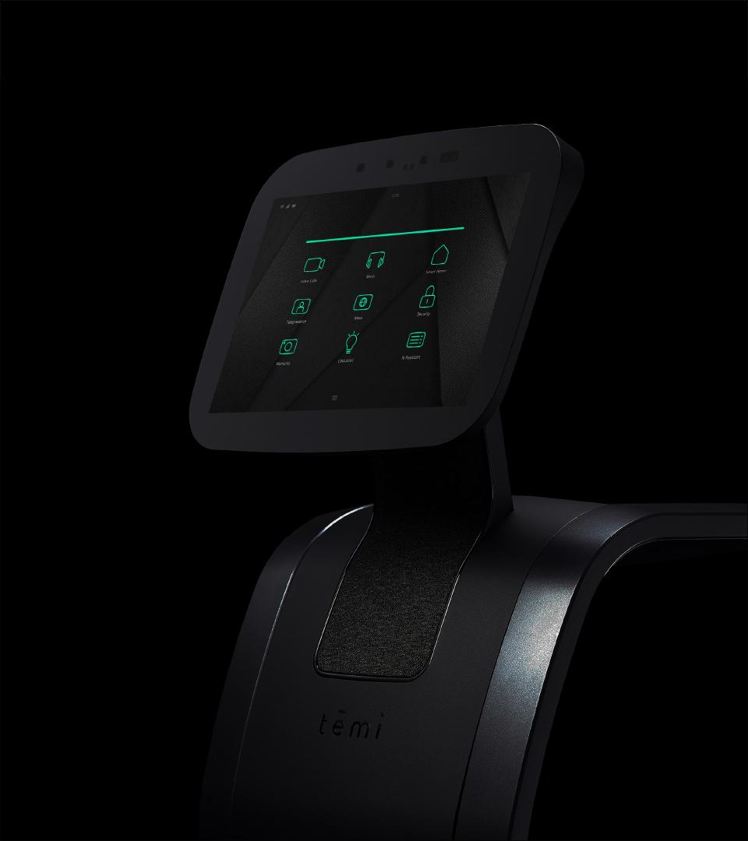
Algorithm flow overview
Sample phase , amp , flags and ambient images
Image processing
PCL Point cloud generation using lens calibration in base link frame
Prelabel according to images
Pointcloud filtering to final labels
Publishing ()

Slide 7
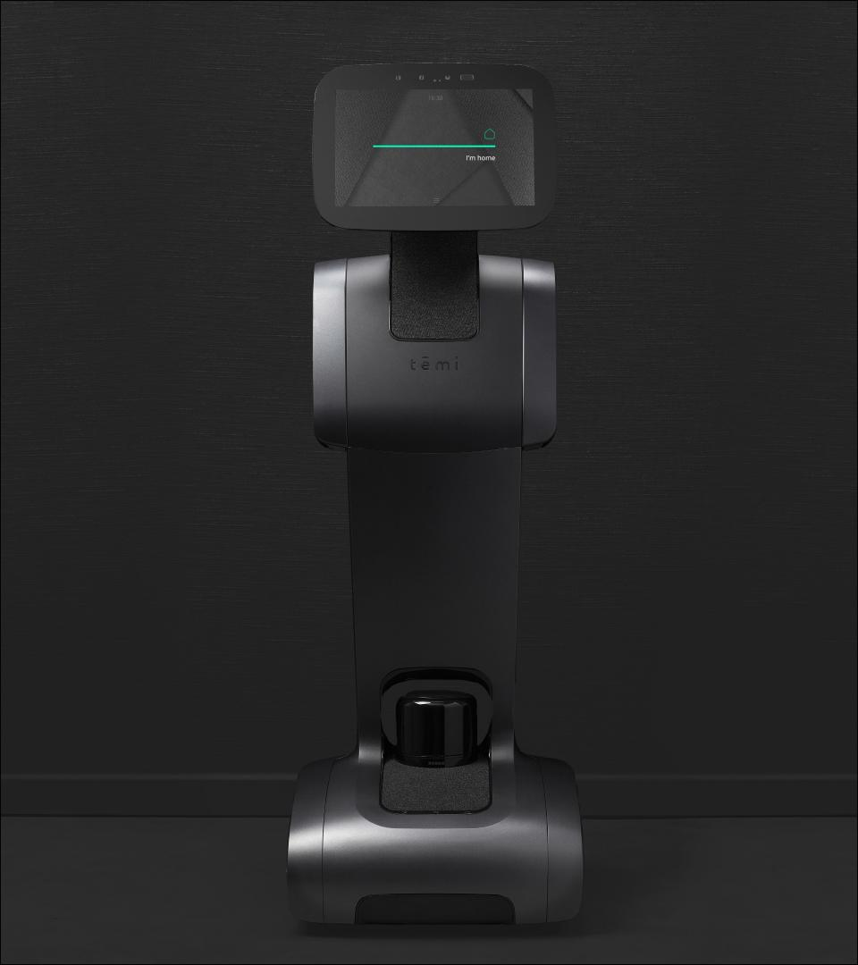
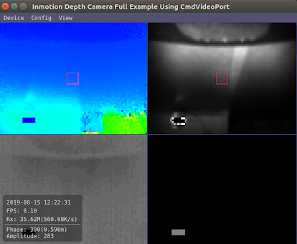
Sampling: raw data
Depth (phase), amplitude , ambient and flags

Slide 8
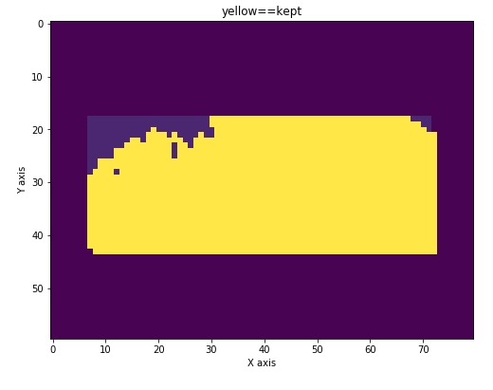


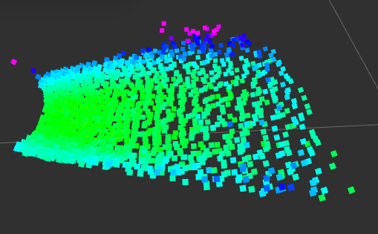
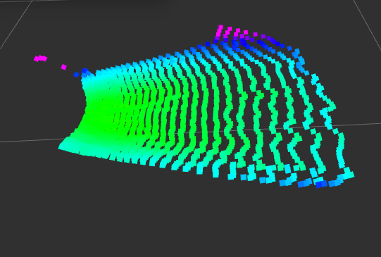
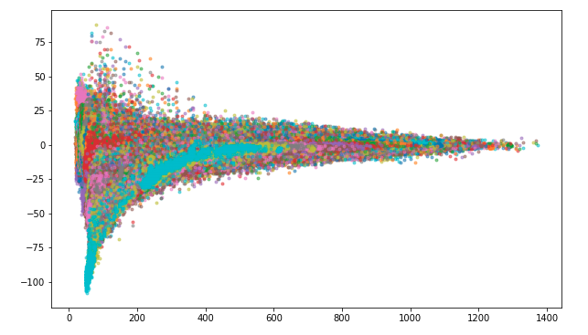
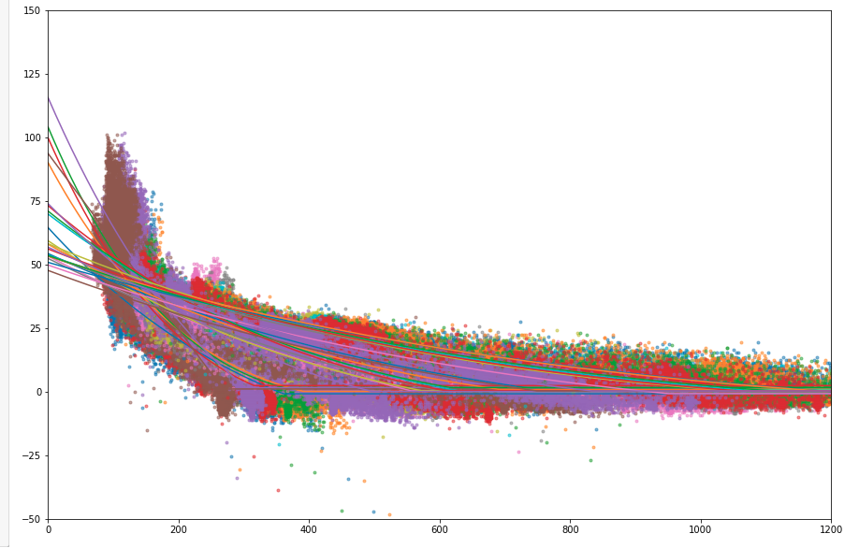
Image processing
Crop images to cut Temi’s front and other irrelevant areas due to laser divergence
Apply Gaussian blur to smoothen noise
Apply black correction ( disabled )

Slide 9
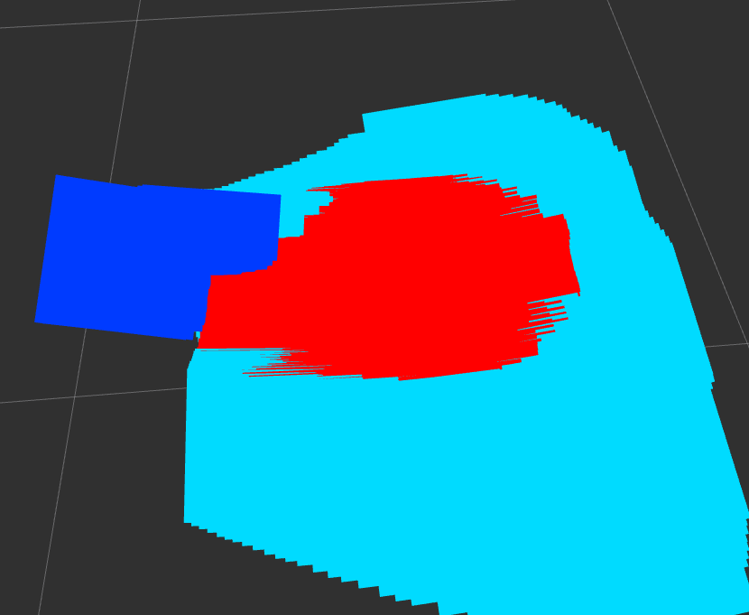
Prelabel according to images
“Weak filter” | “Burn” | “Glare” | “Clear”
Amplitude < 120 | flags > 0 | ambient > ambient thresh | everything else
Phase > ~500

Slide 10
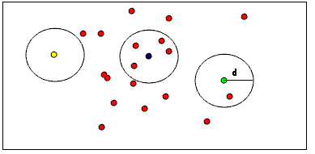
Point cloud filtering (obstacle detector.cpp) - removeRadiusOutliers:
“Strong filter”
points # > 10 at a radius < 0.08m

Slide 11
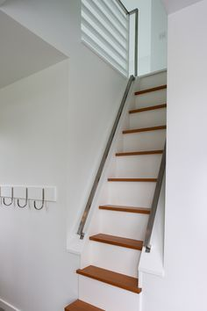
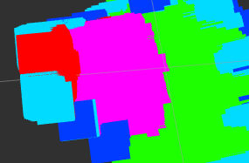
Point cloud filtering (obstacle detector.cpp) - detectStairway
“Abyss”
not “strong filter” and points # > 5 and z < -0.15m

Slide 12
Framing the suspects:
“Weak filter” | “Burn” | “Glare” | “Clear”
Amplitude < 120 | flags > 0 | ambient > ambient thresh | everything else
Phase > ~500
“Strong filter”
points # > 10 at a radius < 0.08m
“suspect”
not an “inflated” plane inliner
ransac plane segmentation
intersection of complementary points
“Abyss”
not “strong filter” and points # > 5 and z < -0.15m

Slide 13
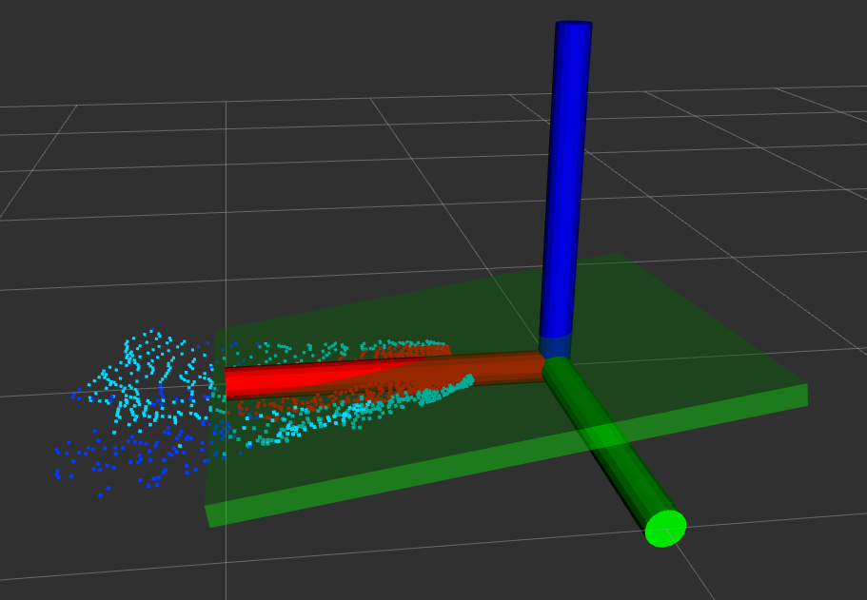
Point cloud filtering (obstacle detector.cpp) - planeSegmentation:
Get best fitting plane using RANSAC:
choose 3 random points that can make up a plane
determine how many inliers are inside the plane
calculate number of iterations required to establish with 0.99 probability that the 3 points from step 1 were all inliners assuming the current best inlliners / population is a good representative of the probability to find an inliner
keep track of the best model of inliners while checking # of iterations is less than the thresh calculated at step 3
Plane model constraints:
max +-15 degrees from base link z axis ( blue axis )
Inliners are considered points that are +-0.01m away from the plane
Using the best model coefficients an inflated set of inliners is calculated with distance -0.03 below the plane and 0.01 + 0.02 * point_base_link_x distance

Slide 14
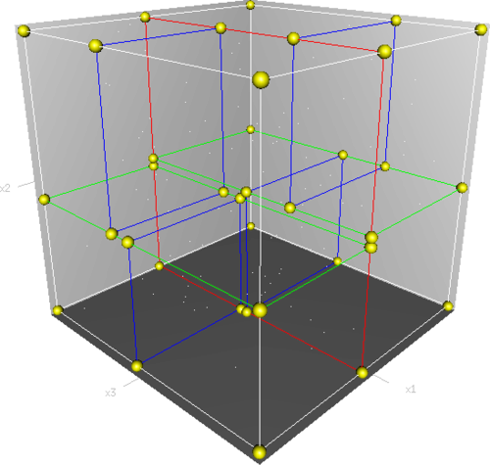
clustering:
Reduces chunks from search space when looking for nearest neighbors < R
Clustering to 50 - 1500 points clusters with a 0.1m euclidean distance between points
Kdtree sorting of all plane outliers

Slide 15
Final labeling
“Abyss” | “Obstacle” | “Clear”
centroid dist from plane < linear changing thresh | centroid dist from plane > linear changing thresh and mean amplitude > 100 | everything else not detected by steep abyss
“suspect”
not an “inflated” plane inliner
clustering
centroids
+
“Abyss”
not “strong filter” and points # > 5 and z < -0.15m

Slide 16




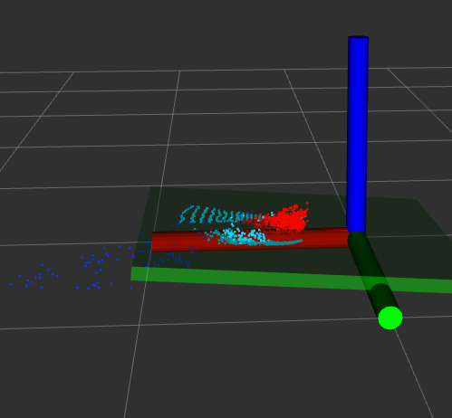
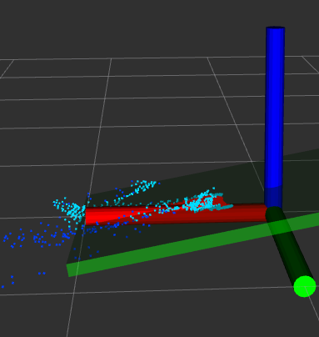
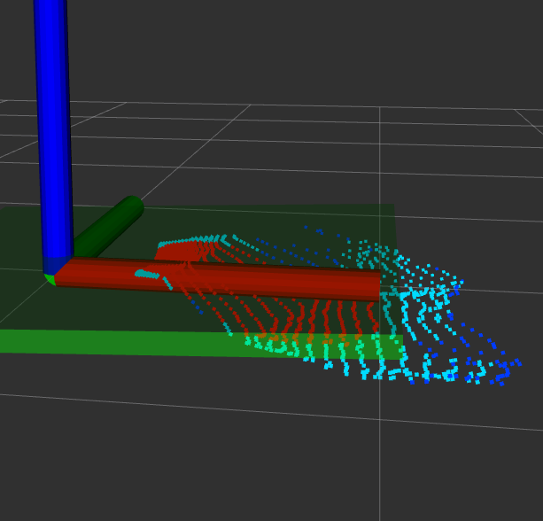
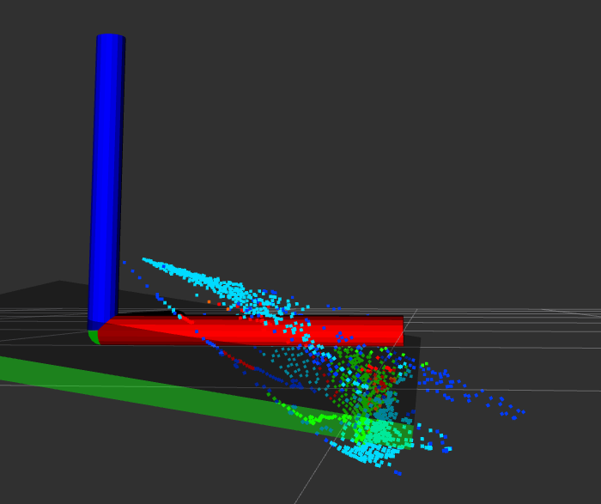
Automation: tests
Clear - no obstacles or abyss detected in the bag
Abyss - averge of abyss points is detected at each frame
Obstacles - average of obstacle points detected is above a thresh

Slide 17
questions?

